Slide 1
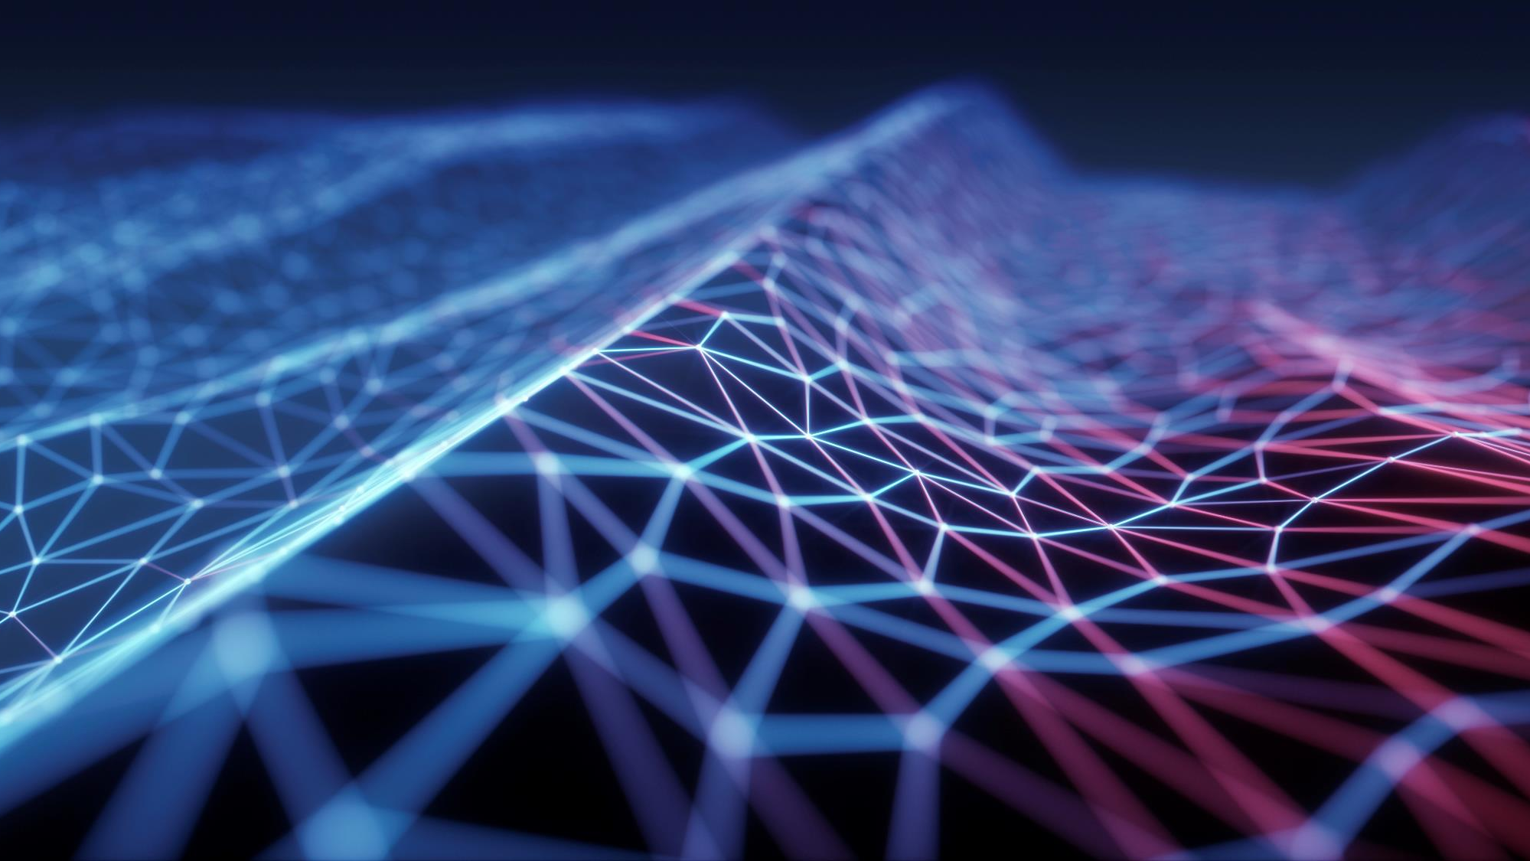
NUTRISCAN – AI Powered nutrition assistant
Milestone III – Emanuele Barbato – Lukas Hufnagel

Slide 2
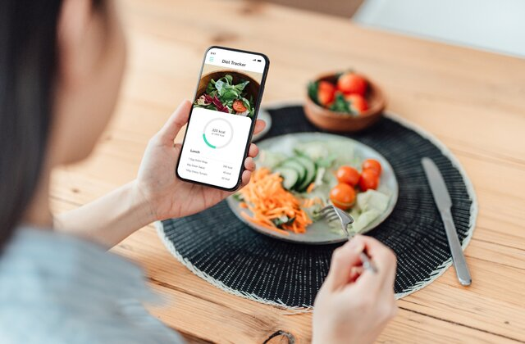
Project overview
Context
Deep Learning element responsible of scanning portion of meals and providing nutritional information. Usage of custom curated dataset (Nutrition14) for classification of 14 macro-categories of food:
Chicken
Berries
High-Sugar Fruits
Cooking Vegs
Oatmeals/Cereals
Pork
Beef
Problem
Manual calorie tracking is tedious and error- prone
Solution
An AI-powered application that recognizes food from images and estimates nutritional content instantly.
Pizza
Potatoes
Leafy Greens
Eggs
Legumes
Rice
Fish

Slide 3
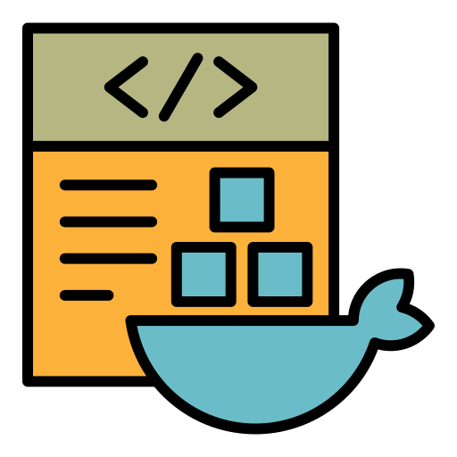
System architecture
Core Model
Vision Transformer (ViT), nateraw/food fine- tuned on custom curated dataset
Frontend/GUI
Streamlit (Python based web framework)
Deployment
Docker (Containerization for portability)
Data Source
Local JSON Database for nutritional mapping (approximate macros for 100 gr.)

Slide 4
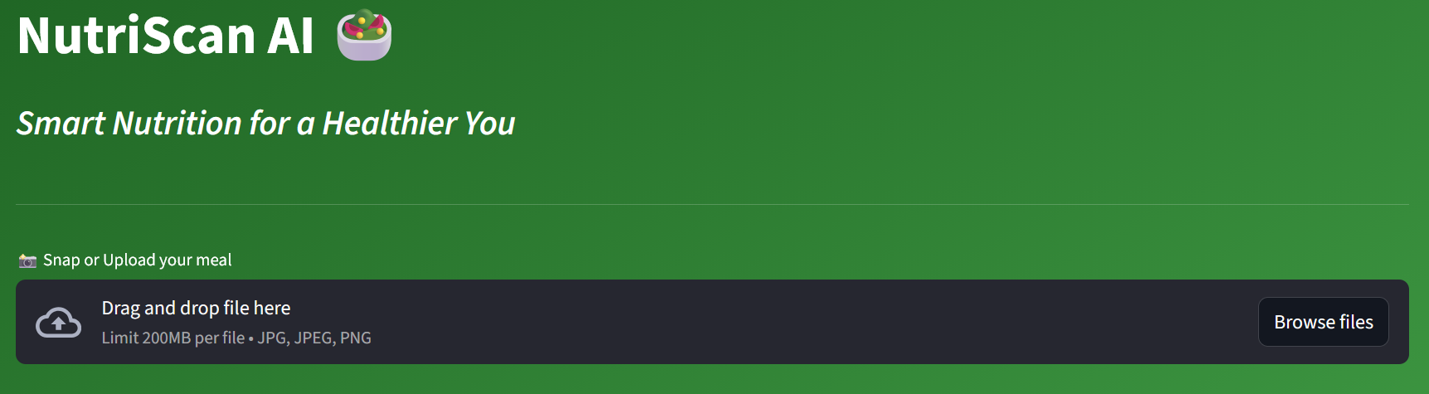
User interface design
Design Philosophy
Minimalist, «Green» theme to evoke health and wellness
Usability
Single-page application; Clear «Drag and Drop» interface

Slide 5
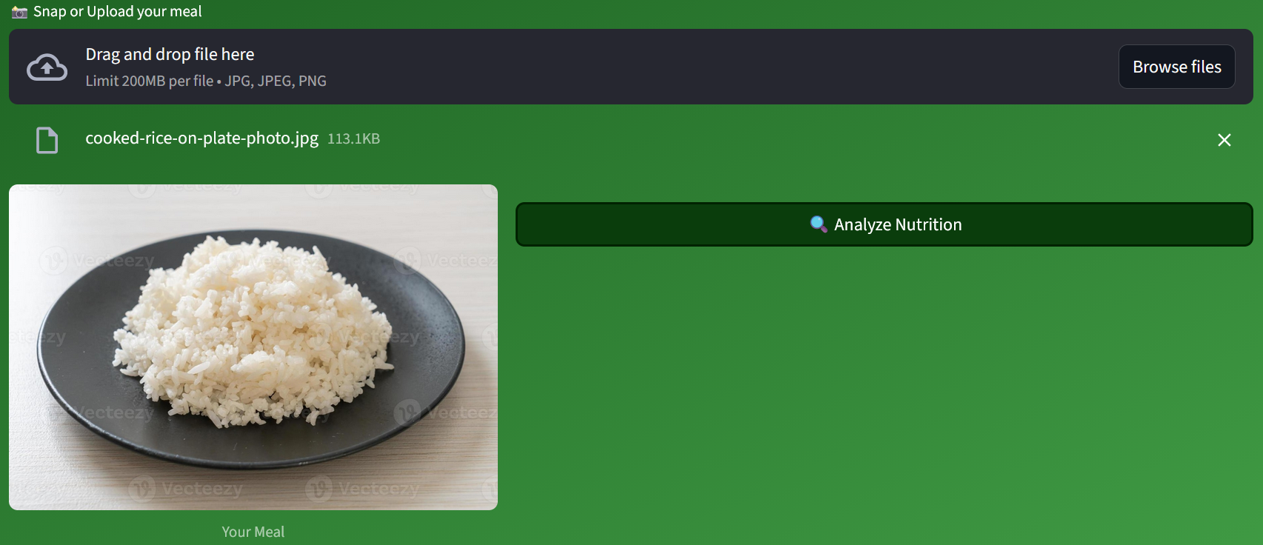
Workflow: Image upload
Supports multiple formats (JPG, PNG)
Immediate visual and feedback with the image preview
«Analyze Nutrition» button triggers the inference engine only when requested (saves compute resources)

Slide 6
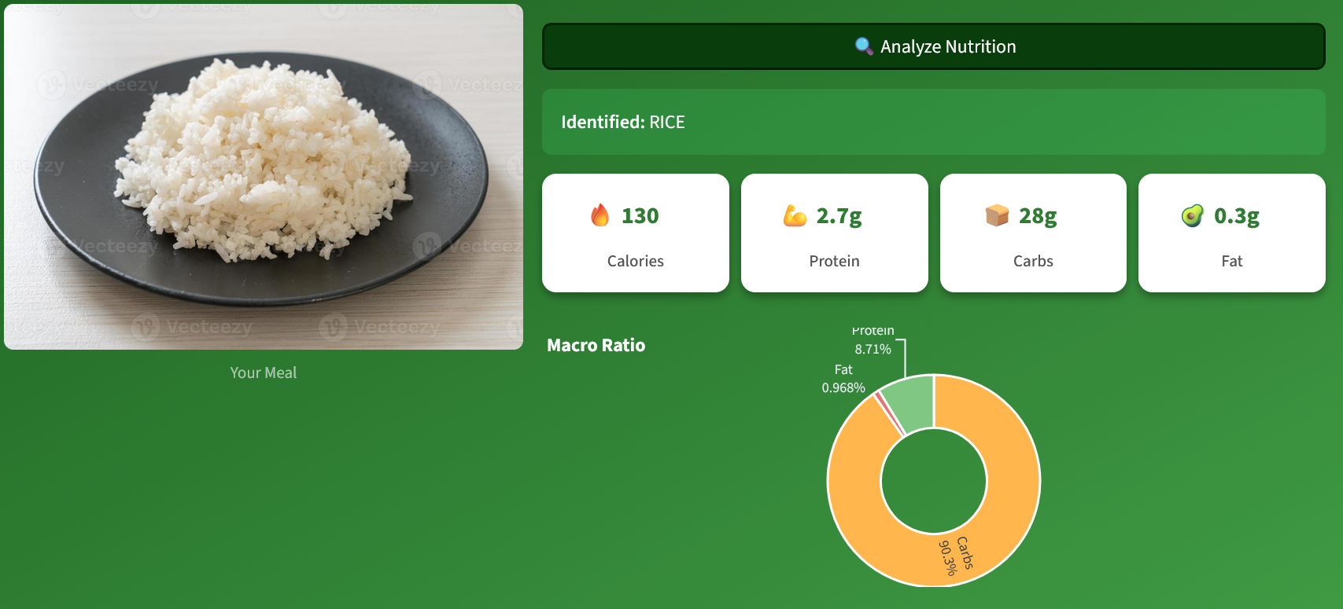
Workflow: Analysis & results (Rice example)
Identification
The model correctly predicts the class «RICE»
Data Mapping
The app retrieves the corresponding macros (Calories, Protein, Carbs, Fat) from nutrition_data.json
Visualization
Donut chart provides an immediate understanding of the macro ratio (High Carb)
Notes:
Compact boxes (stability) for accuracy with lr 5 e -5

Slide 7
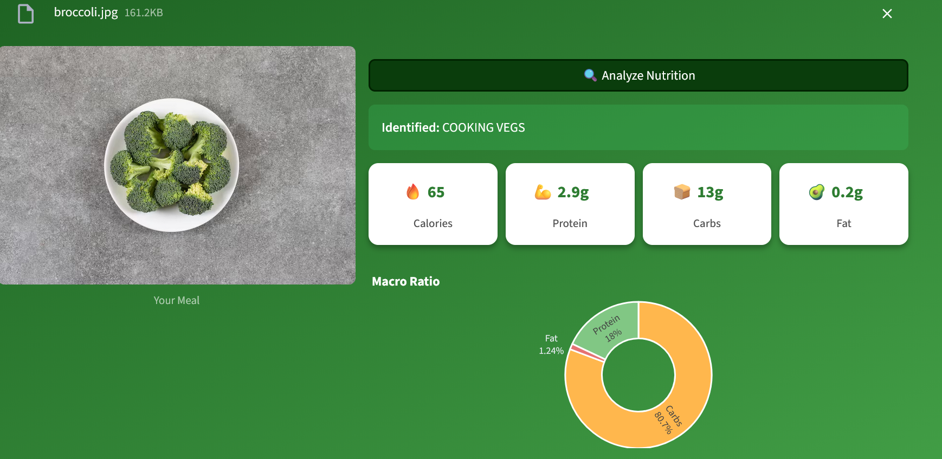
Robustness Check (broccoli example)
Demonstration of a different class tested («COOKING VEGS»)
Shows the system's ability to adapt: different color palette (green vs. white rice) and different nutritional profile (low calorie vs. high calorie).
Notes:
Compact boxes (stability) for accuracy with lr 5 e -5

Slide 8
Deployment strategy: dockerization
Base Image
python:3.9-slim (Chosen for lightweight footprint).
Optimization
Installed PyTorch CPU version explicitly.
Why? Drastically reduced image size (from ~4GB to ~1GB) and removed dependency on NVIDIA drivers for demo.
Layer Caching
requirements.txt is copied and installed before the application code. This allows fast rebuilding when modifying app.py

Slide 9
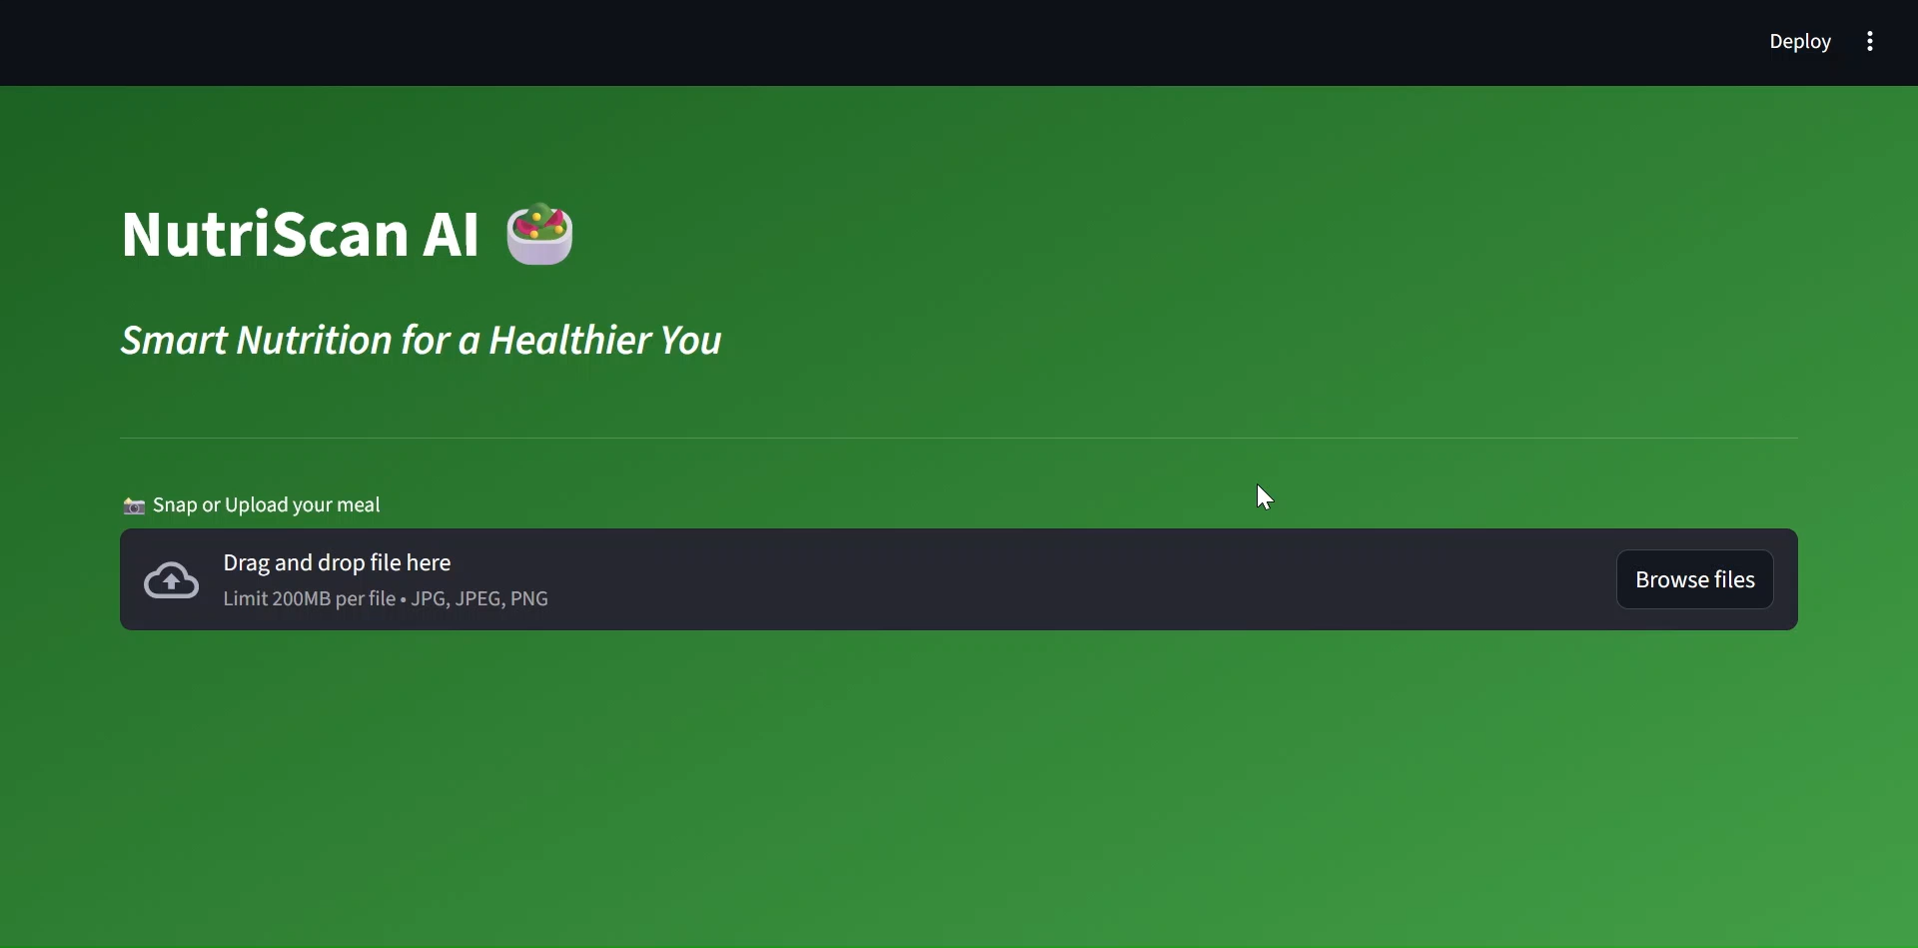
DEMO VIDEO

